Slide 1

Did you know ?
Youtube, which has 2 billion monthly active users and is the second most-visited website on the internet, currently exists solely within Google’s internal data centre infrastructure.
Notes:
Google Cloud platform can handle the workload of YouTube. https://www.digitaltveurope.com/2021/06/07/google-shifts-parts-of-youtube-to-google-cloud-platform/#close-modal
google.com = 131,200,000,000
youtube.com = 71,400,000,000
According to a research conducted as of September 2024, by https://explodingtopics.com/blog/most-visited-websites.
Who knows what the most visited website is ?

Slide 2


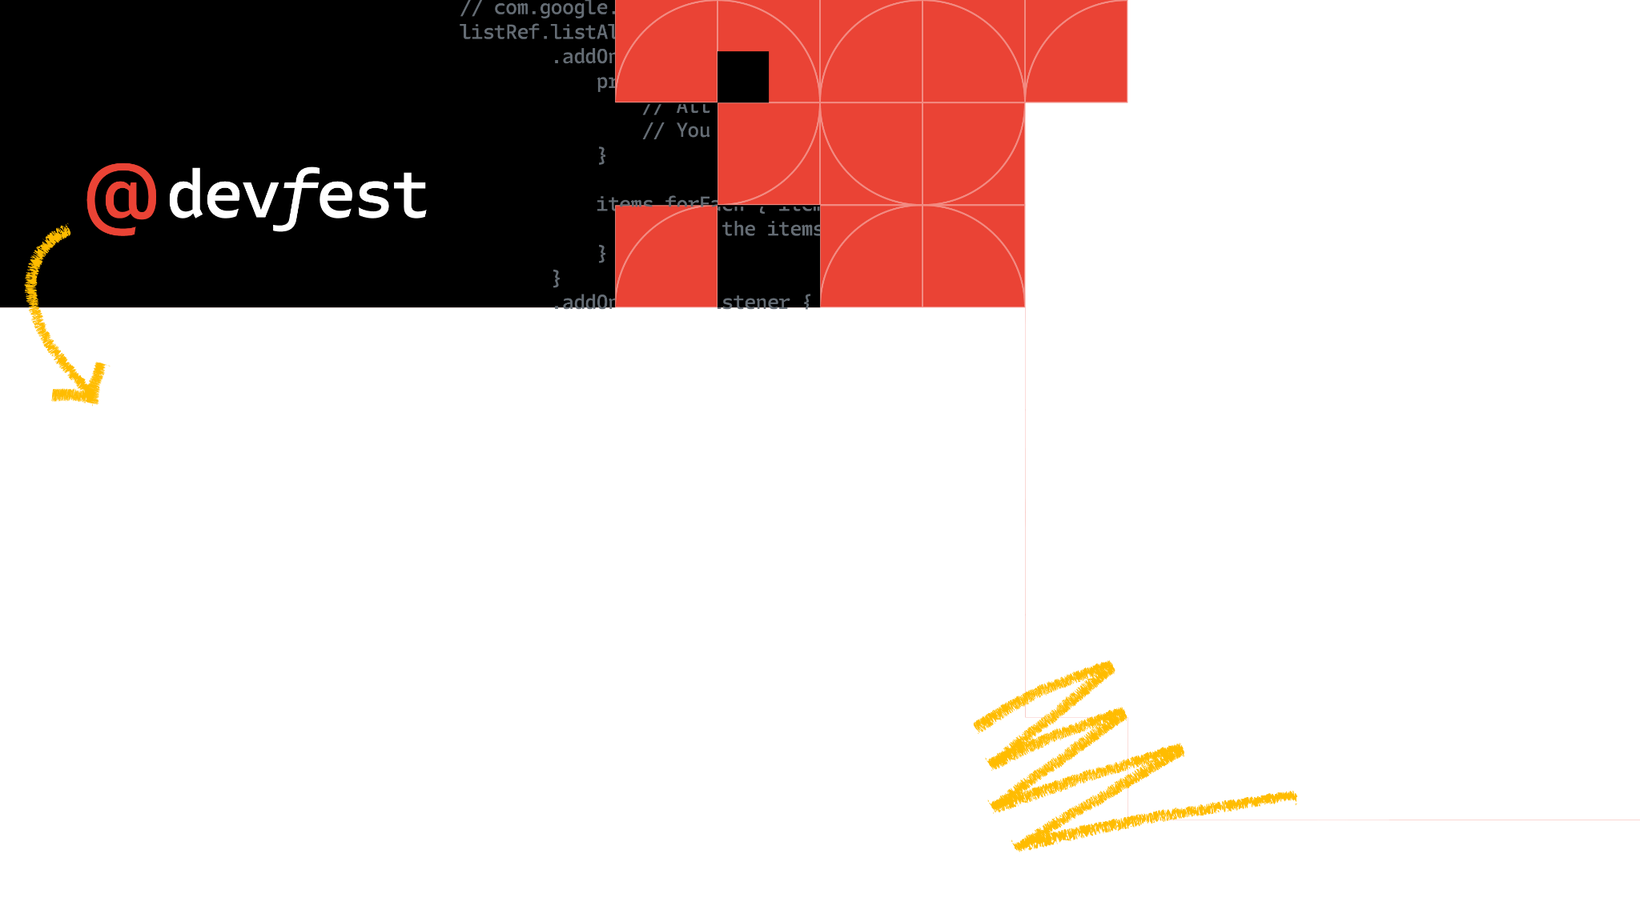

Cloud Essentials and Storage Basics
Google Cloud Skills for Africa
2024
Samuel Macharia - Cloud Engineer
Notes:
I am Cloud Engineer and a community advocate. I do enjoy inspiring others through what I learn in tech with todays focus on the Google Cloud Platform.

Slide 3
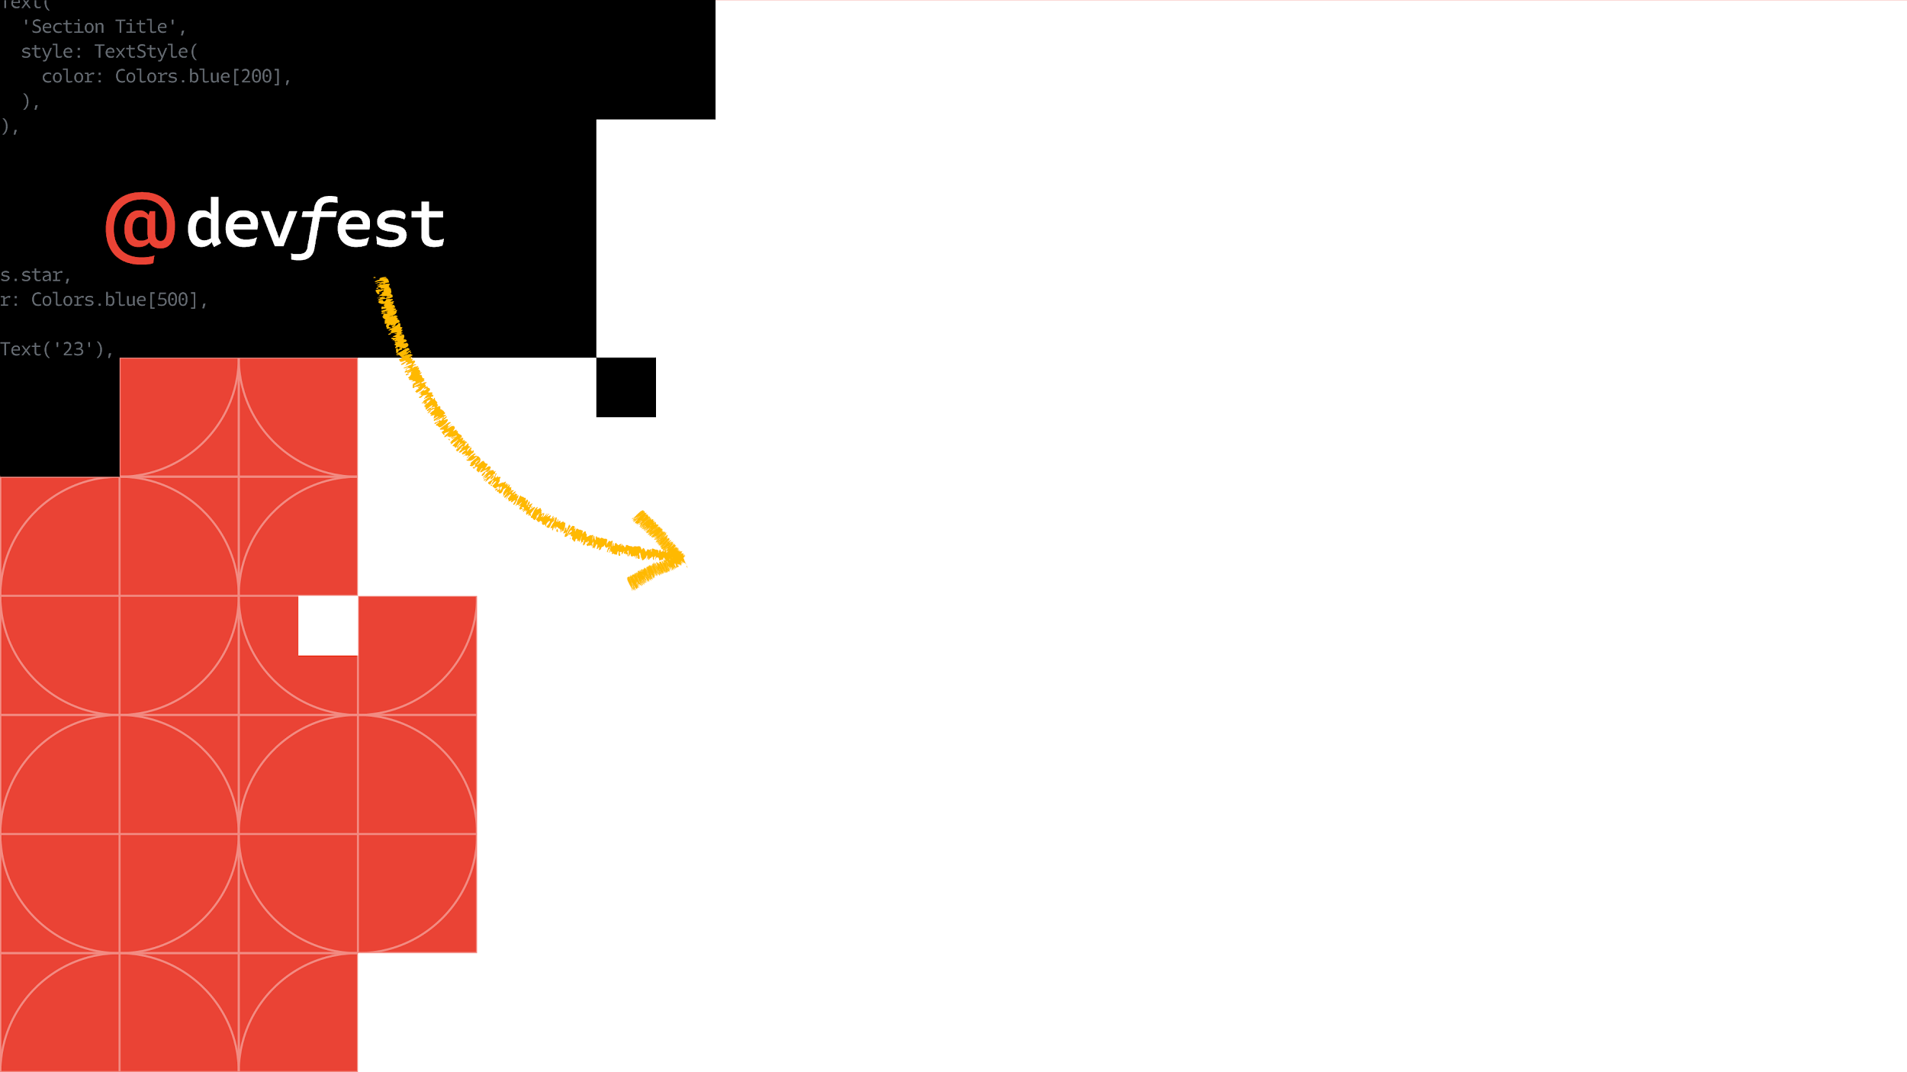
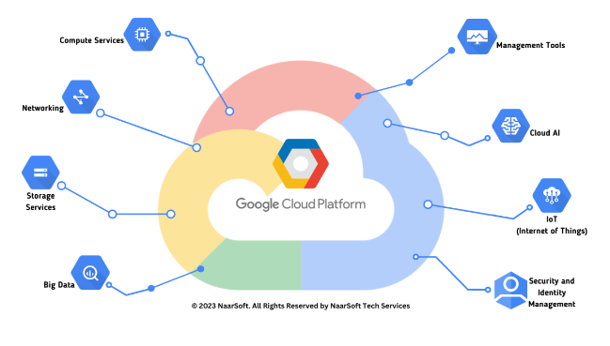
Google Cloud Essentials Overview
Google Cloud Skills for Africa
Purpose: Helps beginners gain practical skills with key Google Cloud technologies.
Completion Recognition: Digital badge awarded after course completion.
Topics Covered: Cloud Shell, Kubernetes Engine, Virtual Machines, Load Balancers.
2024
Notes:
Hands-On Labs: Includes real-world exercises on Google’s cloud ecosystem.
Topics Covered: Cloud Shell, Kubernetes Engine, Virtual Machines, Load Balancers.
User-Friendly Format: Brief videos guide users through each technology.
Completion Recognition: Digital badge awarded after course completion.
The digital badge from Google Cloud labs is important for several reasons:
Proof of Skill Development: The badge certifies that you've completed a structured learning path, showcasing your foundational skills in Google Cloud.
Recognition of Hands-On Experience: Earning a badge through Google Cloud labs emphasizes your practical experience with core Google Cloud services, such as Cloud Shell, Kubernetes Engine, and Virtual Machines, rather than just theoretical knowledge.
Career Advancement: Badges are often shared on platforms like LinkedIn, allowing potential employers or colleagues to see your expertise, which can boost your job opportunities and career growth.
Builds Credibility and Confidence: For beginners or professionals transitioning to cloud technology, a badge reflects your commitment to learning Google Cloud, which builds credibility in technical discussions or collaborations.
Benchmark for Progress: Completing labs and earning the badge is a concrete way to measure your progress in cloud computing, especially if you're moving toward more advanced certifications or roles in cloud infrastructure.
Community Recognition: Google Cloud badges are well-recognized in tech communities and can help you connect with other professionals and learners, creating networking opportunities and group support as you further develop your skills.
Footnote: Google Cloud Essentials serves as the ideal starting point for cloud beginners, covering essential services and tools in the Google Cloud environment. It emphasizes hands-on experience, making abstract cloud concepts more tangible.

Slide 4
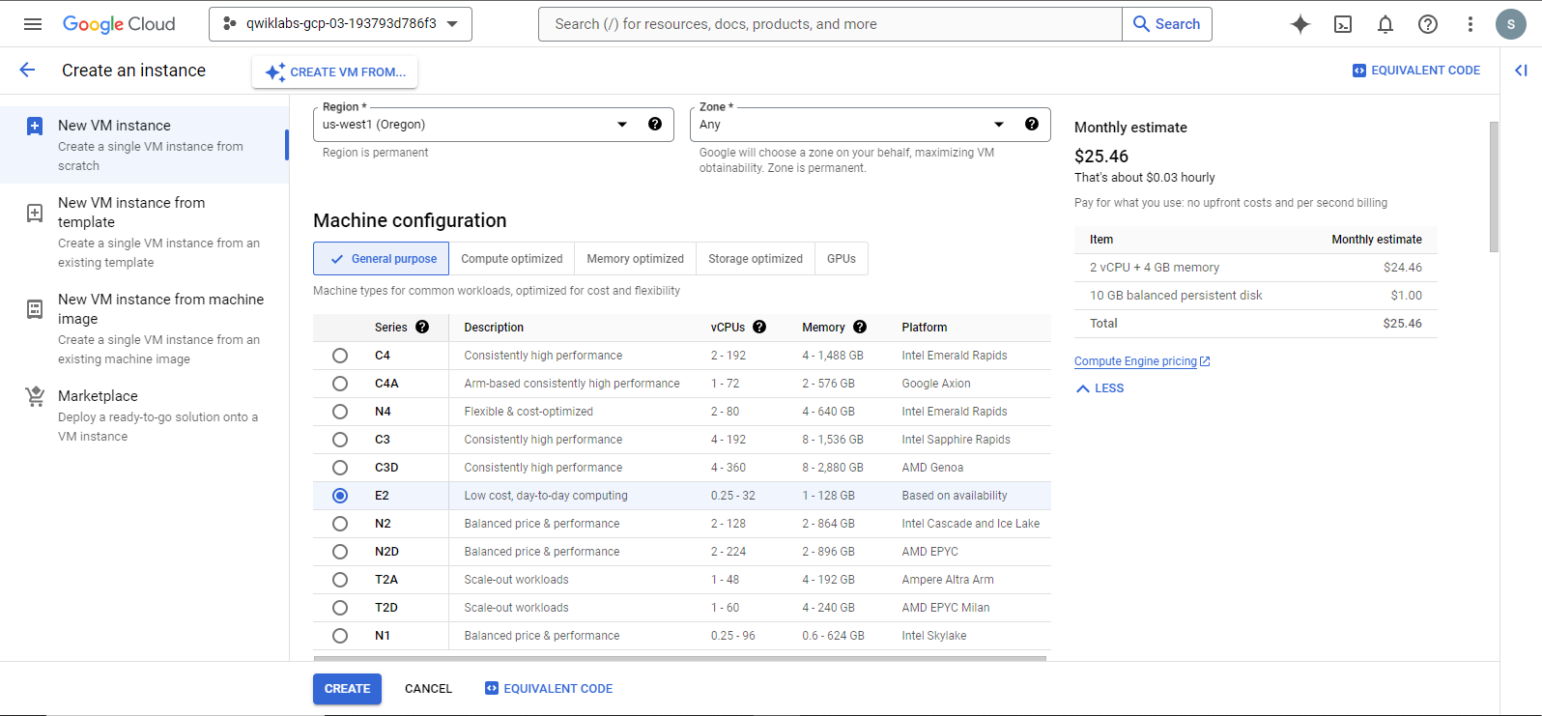
Virtual Machines (VM) on Google Cloud
What is a Virtual Machine? A VM is an emulated computer environment within a physical machine.
Google Compute Engine (GCE): Google’s service for creating and managing VMs.
Use Case: Running applications without physical hardware constraints.
Notes:
Regions and Zones: VMs can be deployed in multiple geographic locations.
Example: Hosting a website on a VM in a specific region for low latency.
Hands-On Lab: Learn how to deploy VMs and configure machine types.
Footnote: VMs offer flexibility and scalability, especially for companies that need isolated environments for testing or specific software setups. Google Compute Engine simplifies VM setup with tools for monitoring and scaling.

Slide 5
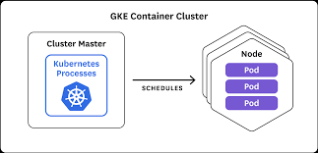
Google Kubernetes Engine (GKE)
What is Kubernetes? An open-source system for automating container deployment.
Google Kubernetes Engine: Google’s managed Kubernetes service.
Purpose of GKE: Simplifies deployment and scaling of containerized apps.
Containers in Practice: Packages code and dependencies for easy portability.
Example: Running a microservices-based web app that scales automatically.
Notes:
Why Containerize an app ? It offers several benefits that streamline development, deployment, and management of applications. Here’s why it’s widely adopted:
Consistency Across Environments: Containers package an application with all its dependencies, ensuring it runs consistently across different environments—whether on a developer’s laptop, a test server, or in production.
Isolation: Containers isolate applications from one another and from the underlying infrastructure. This isolation avoids conflicts, such as dependency clashes, and enhances security by limiting each container's access.
Scalability: Containers make it easier to scale applications up or down based on demand. With container orchestration tools like Kubernetes, scaling out multiple instances of an application becomes straightforward and automated.
Kubernetes could be used to enhance Jumia's e-commerce platform by managing and scaling its containerized microservices architecture. Each component of the website, such as product listings, user accounts, shopping carts, and payment processing, can be containerized, allowing these services to be independently deployed, updated, and scaled. Kubernetes orchestrates these containers across clusters, ensuring that Jumia’s services remain highly available and can automatically scale to handle spikes in user traffic, especially during promotions or holiday seasons.
In Kubernetes, the cluster master (also known as the control plane) and nodes are essential components for managing and running containerized applications:
Cluster Master (Control Plane): The cluster master is the central control system in Kubernetes. It manages the entire Kubernetes cluster, coordinating tasks like scheduling applications, maintaining the desired state of applications, scaling, and monitoring the health of nodes and applications. It consists of several key components:
API Server: Serves as the communication point for the cluster, receiving and processing instructions from users and other components.
Scheduler: Decides which nodes will run newly created or scaled containers.
Controller Manager: Handles various controllers that enforce the desired state of the cluster, like restarting failed containers.
etcd: A distributed key-value store that maintains the cluster's configuration data, ensuring consistent cluster state.
Node: A node (or worker node) is a machine within the cluster that actually runs the containers. Nodes can be virtual or physical machines, each having its own set of resources like CPU, memory, and storage. Every node includes:
Kubelet: An agent that communicates with the cluster master and ensures containers are running as specified.
Kube-proxy: Manages network routing for services on that node, allowing containers to communicate within and outside the cluster.
Container Runtime (e.g., Docker, containerd): Runs the actual containerized applications.
Together, the cluster master orchestrates and manages nodes, enabling Kubernetes to handle the lifecycle and scaling of applications effectively across multiple machines.

Slide 6

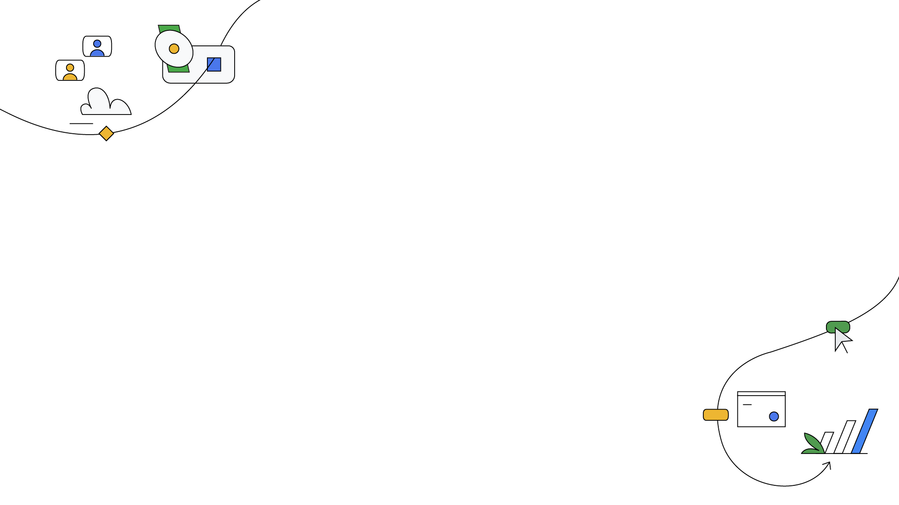
Cloud Shell and gcloud SDK
What is Cloud Shell? A command-line tool accessible through the Google
Cloud Console.
Purpose of Cloud Shell: Manage and configure Google Cloud resources via command-line.
What is gcloud SDK? Google’s command-line tool for managing resources.
Use Case: Running scripts or commands directly from the cloud without setup.
Example: Deploying a new VM or Kubernetes cluster from the Cloud Shell.
Notes:
Cloud Shell provides a ready-to-use environment for managing Google Cloud resources without needing local setup, making it an essential tool for fast, remote resource management.

Slide 7
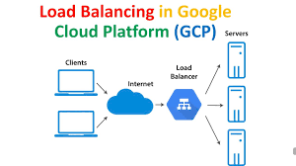
Network and Application Load Balancing
What is Load Balancing? Distributes incoming network traffic across multiple servers.
Google Cloud Load Balancers: Managed services for traffic distribution.
Network Load Balancer: Ideal for handling large volumes of network requests.
Application Load Balancer: Distributes requests based on application needs.
Example: An e-commerce site using load balancing to manage customer traffic.
Notes:
Load balancing is crucial for applications needing high availability and resilience. Google Cloud offers network and application load balancers to help ensure smooth traffic distribution and prevent resource overload.

Slide 8


Slide 9
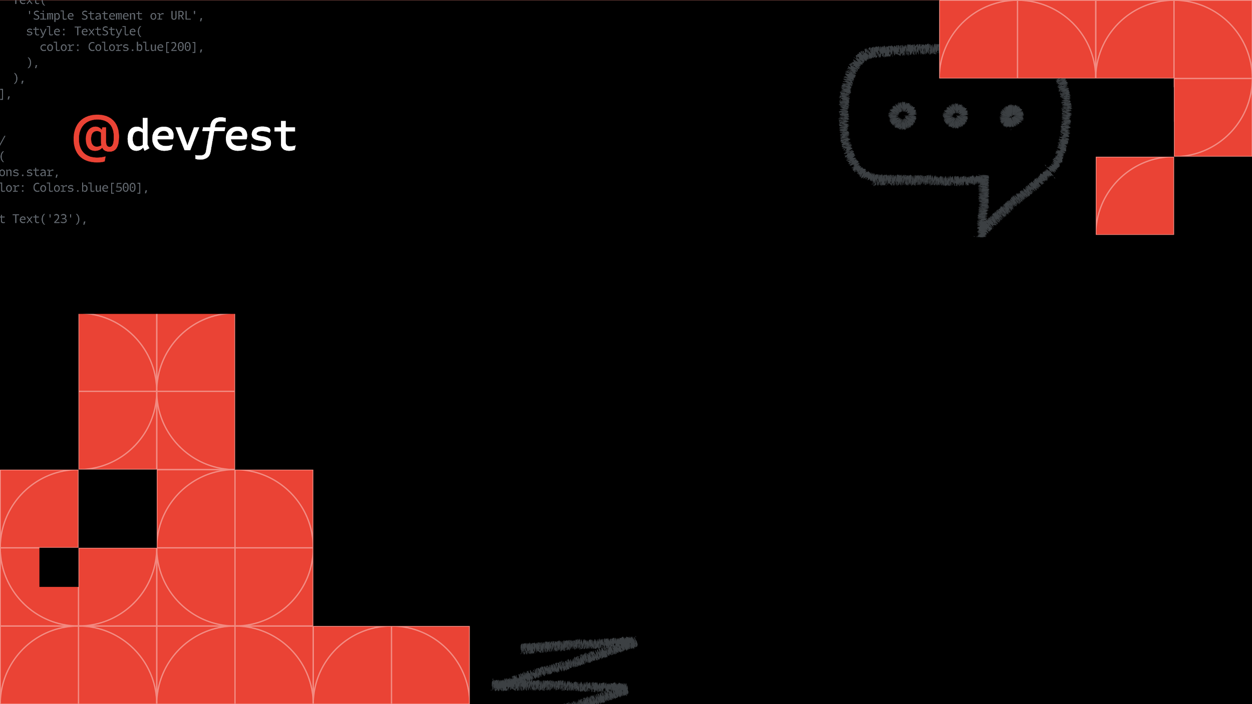
Authentication is the digital key that unlocks the gateway to trust, securing our virtual realms and ensuring that only those with the rightful credentials can navigate the landscapes of the interconnected world
Web Development

Slide 10

Let’s Be Friends :)
@jumason_felix

